Slide 2
Adapter pattern
Adapter pattern works as a bridge between two incompatible interfaces.
This type of design pattern comes under structural pattern as this pattern combines the capability of two independent interfaces.

Slide 3
Adapter pattern
This pattern involves a single class which is responsible to join functionalities of independent or incompatible interfaces.
A real life example could be a case of card reader which acts as an adapter between memory card and a laptop.
You plugin the memory card into card reader and card reader into the laptop so that memory card can be read via laptop.

Slide 4
Adapter pattern
We have a MediaPlayer interface and a concrete class AudioPlayer implementing the MediaPlayer interface. AudioPlayer can play mp3 format audio files by default.
We are having another interface AdvancedMediaPlayer and concrete classes implementing the AdvancedMediaPlayer interface.
These classes can play vlc and mp4 format files. We want to make AudioPlayer to play other formats as well.

Slide 5
Adapter pattern
To attain this, we have created an adapter class MediaAdapter which implements the MediaPlayerinterface and uses AdvancedMediaPlayer objects to play the required format.
AudioPlayer uses the adapter class MediaAdapter passing it the desired audio type without knowing the actual class which can play the desired format.

Slide 6
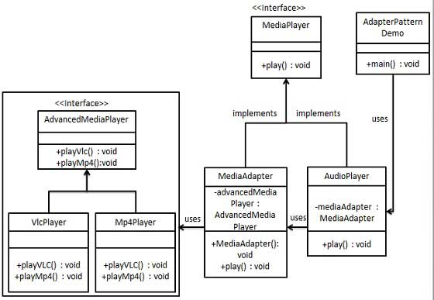
Adapter pattern

Slide 7
Adapter pattern – Step 1
Create interfaces for Media Player and Advanced Media Player.
MediaPlayer.java
public interface MediaPlayer {
public void play(String audioType, String fileName);
}
AdvancedMediaPlayer.java
public interface AdvancedMediaPlayer {
public void playVlc(String fileName); public void playMp4(String fileName);
}

Slide 8
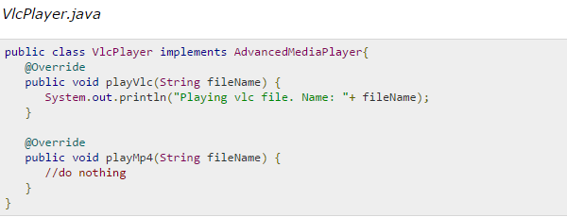
Adapter pattern – Step 2
Create concrete classes implementing the AdvancedMediaPlayer interface.

Slide 9
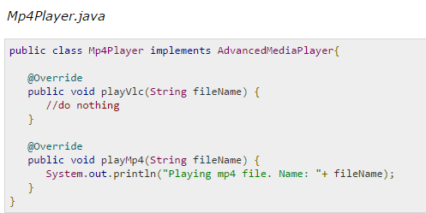
Adapter pattern – Step 2
Create concrete classes implementing the AdvancedMediaPlayer interface.

Slide 10
Adapter pattern – Step 3
Create adapter class implementing the MediaPlayer interface.

